Slide 1

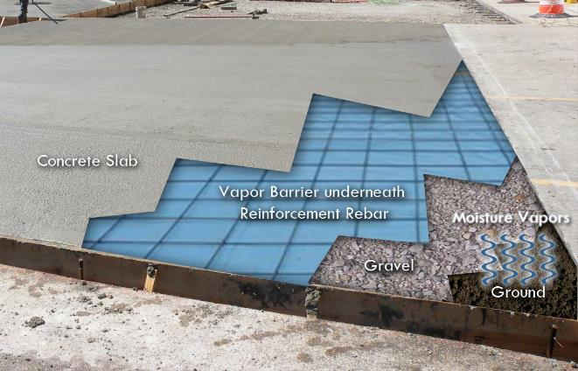
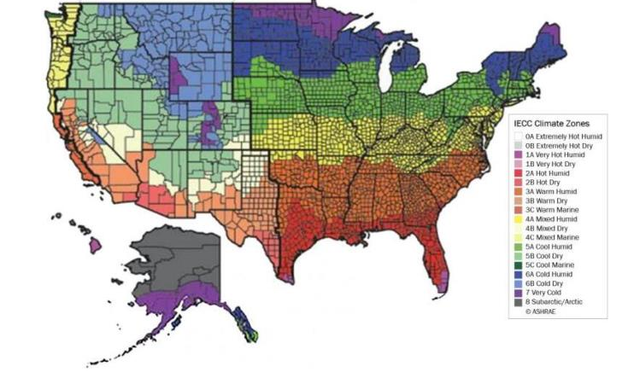
Construction Underlayment Film
Construction Underlayment/Vapor barrier wrap
Provides a barrier to moisture migration from the ground into the building
Prevents issues such as mold growth, concrete degradation, and potential damage to building materials
Key Performance Property | Class A | Class B | Class C
Water Vapor Permeance | 0.1 perms | 0.1 perms | 0.1 perms
Tensile Strength | 45.0 lbf/in. | 30.0 lbf/in. | 13.6 lbf/in.
Puncture Resistance Dart Impact | 2.200 grams | 1.700 grams | 475 grams
Three Key Classification Criteria
Permeance – resistance to migration of moisture
Impact/puncture resistance
Tensile Strength
Three Classes of Vapor Barrier Underlayment Film
Class A, Class B, and Class C
Same barrier/permeance performance requirement of 0.1 perms for Class A – Class C
Classes differentiated based upon puncture and tensile strength
Market Insights
Heavy gauge structures varying in thickness from 6 – 20+mil
Solution utilized depends on building requirements, geography, and local building codes

Slide 2
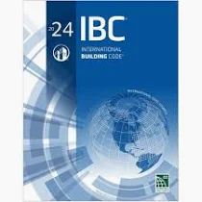

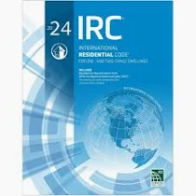

Industry Codes & Standards
International Building Code
International Residential Code
ASTM International
American Concrete Institute
Vapor retarder Class I, II, or III based upon building codes
Section 1907 – Slabs on Ground
ASTM E1745 - Standard Specification for Plastic Water Vapor Retarders Used in Contact with Soil or Granular Fill under Concrete Slabs
  Class A, B, or C
  All under slab structures are Class I materials
ASTM E154 - Standard Test Methods for Water Vapor Retarders Used in Contact with Earth Under Concrete Slabs, on Walls, or as Ground Cover
R506.2.3 Vapor retarder must be a minimum of 10 mil
ACI 302.1R-15 - GUIDE TO CONCRETE FLOOR AND SLAB CONSTRUCTION
State and local codes leverage framework established by these industry organizations.

Slide 3
Construction Underlayment
ASTM E1745 Class A Product Performance
Key Performance Property | ASTM Method | Units | ASTM E1745 Class A | 10A | 15A | 20A
Water Vapor Permeance 23°C, 100% RH | F1249 | perms | 0.1 | 0.017 | 0.008 | 0.004
Tensile Strength | D882 | lbf./in | 45 | 50 | 80 | 90
Puncture Resistance | D1709 | grams | 2,200 | >3,300 | >3,000 | >3,300

Slide 4
Permeance
Performance Property Summary
Permeance exceeds Class A requirements
10A, 15A, and 20A are below 0.1 perms
15A and 20A are below 0.01 perms

Slide 5
Tensile Strength
Performance Property Summary
Tensile Strength exceeds Class A requirements
10A, 15A, and 20A are above minimum of 45 lfb./in in MD and TD direction
Tensile Strength, lbf./in
MD/TD

Slide 6
Puncture Resistance
Performance Property Summary
Dart exceeds Class A requirements
10A, 15A, and 20A are above 2,200 grams
ASTM E1745
Class A
10A
15A
20A

